Slide 1
Graphics Design

Slide 2
Web graphics design
Graphic design is the art of creating webpage layout, font color, font type, logos, banners, pictures and other visual and verbal aspects of a website.

Slide 3
Types of web graphics
Web banner design
Logo design
Button/Icon design
Background design
Image editing etc.

Slide 4
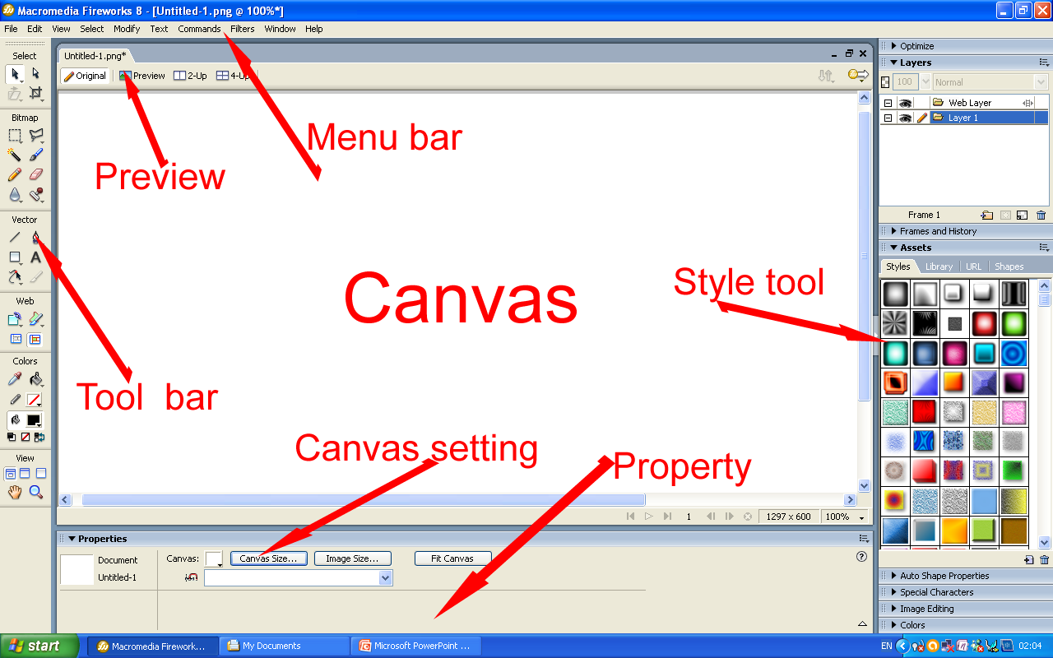
Understanding Firework interface
Menu bar :contains saving and some design tools
Preview tools: for testing the design
Tool bar: contains all the design tool materials
Canvas contain: design space
Style tools: contain different styling materials
Canvas setting: for canvas size and colour settings
Property: for design property settings.

Slide 5
Common design tools at menu bar
Menu bar-modify-combine paths-(punch, union, crop and intersect)
Menu bar-modify-transform-(Skew for rotation, flip and rotate)
Menu bar-commands-creativity-fade image
Menu bar-edit-libraries-bullets and button
Menu bar-edit-text-attach to path

Slide 6
Common design tools at property inspector
Gradient tools
Solid-gradient-linear
Pattern tools
Solid-pattern
Rectangle roundness (for curving the rectangle shape)
Texture=grain or fiber (amount of texture for editing texture)
Opacity (for transparency)
Filter tools(blur shadow and glow)

Slide 7
Other tools
Deselect tools
Pointer tool
Sub selection tool
Other tools
Brush tools
Pencil tools
Line tools
Shape tools(rectangle)
Text tool
Freeform tool
Style tools (located at right hand side)

Slide 8

Banner design

Slide 9

Banner design

Slide 10

Banner design

Slide 11




School Logos

Slide 12

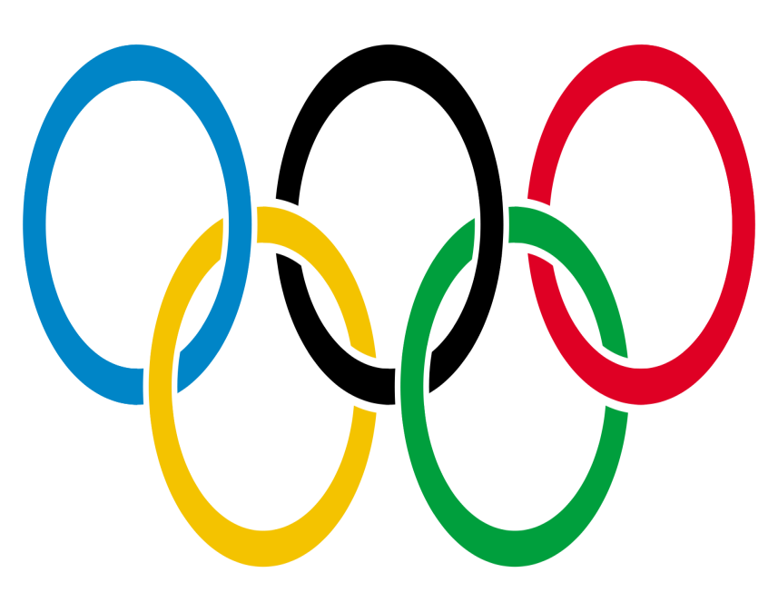




Company Logos

Slide 13
Image editing tools
Marquee tool and oval marquee tool
Polygon lasso tool and lasso tool
Magic wand tool
Eraser tool
Creative fade image

Slide 14
Navigation bar button/ Icon
Steps in creating button in fireworks

Slide 15
?

